Slide 1

Enhancing Stock Price Prediction for Nifty 50 IT Sector Companies: A Comparative Study of ML Models with Feature Selection and Event Data Integration Economics and Finance
First Review
Course Code: CS6510
Course Title: Project 1
24MSP3038
Aniket Shinde
22/11/2024

Slide 2
Problem Statement
Predicting stock prices in the Nifty 50 IT sector is challenging due to high volatility and the impact of market-moving events, making it necessary to use models that integrate event-driven data for improved accuracy

Slide 3
Objectives
Develop a predictive framework for Nifty 50 IT sector stock prices.
Integrate event-driven data to improve forecasting accuracy.
Compare ARIMA, SARIMA, GRU, and LSTM models on multiple metrics.
Identify impactful features through optimized feature selection.
Draw meaningful insights into market movements and forecasting techniques to support informed investment decisions.

Slide 4
Review of Related Literature
Base Paper: https://doi.org/10.1109/iciteics61368.2024.10625537
Author Names: Mohan, B., Yadav, A., Toleti, J., Reddy, D. S. S., Ahmed, R. K., & Koushitha, G.
Title of the paper: Sentiment-driven predictive models for Nifty 50 stock market fluctuations: A time series analysis perspective
Journal Title: IEEE International Conference on Information Technology, Electronics and Intelligent Communication Systems (ICITEICS)

Slide 5
Review of Related Literature (cont.)
Outcomes
LSTM achieved effective predictions with MSE of 24.4 and RMSE of 4.9.
Highlighted the importance of integrating sentiment-driven data for improved forecasting.
Points Taken into Consideration for Methodology
Incorporate sentiment analysis to capture market changes.
Evaluate multiple models, including hybrid approaches.
Experiment with data sources and optimize hyperparameters.

Slide 6
Dataset
Source of the Dataset: Yahoo Finance API
No. of Observations: 4495
Column/Feature Details: Date, HCLTECH.NS_Adj Close, INFY.NS_Adj Close, TCS.NS_Adj Close, TECHM.NS_Adj Close, WIPRO.NS_Adj Close, HCLTECH.NS_Close, INFY.NS_Close, TCS.NS_Close, TECHM.NS_Close, WIPRO.NS_Close, HCLTECH.NS_High, INFY.NS_High, TCS.NS_High, TECHM.NS_High, WIPRO.NS_High, HCLTECH.NS_Low, INFY.NS_Low, TCS.NS_Low, TECHM.NS_Low, WIPRO.NS_Low, HCLTECH.NS_Open, INFY.NS_Open, TCS.NS_Open, TECHM.NS_Open, WIPRO.NS_Open, HCLTECH.NS_Volume, INFY.NS_Volume, TCS.NS_Volume, TECHM.NS_Volume, WIPRO.NS_Volume
Details about the columns:
Date: Discrete (time-series feature)
Price-related columns (Adj Close, Close, High, Low, Open): Continuous
Volume columns: Discrete (countable values)

Slide 7
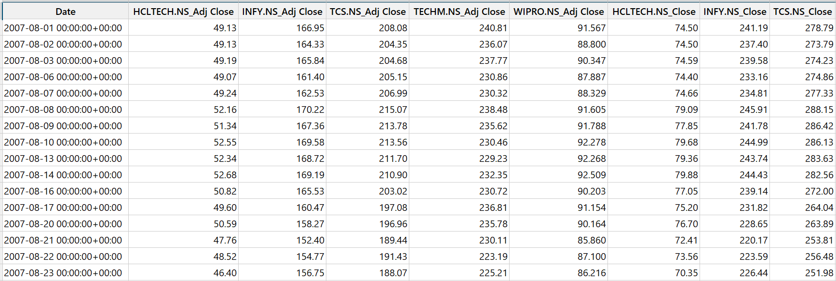
Dataset
Screenshot of the dataset

Slide 8
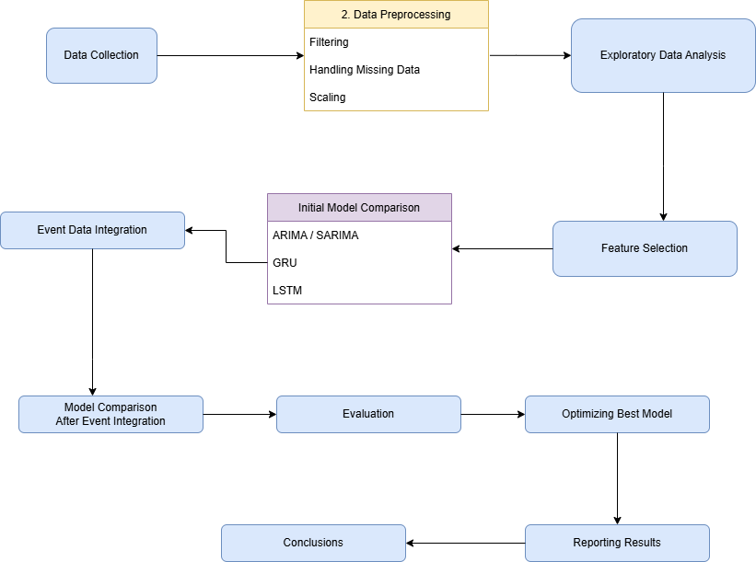
Proposed Methodology

Slide 9
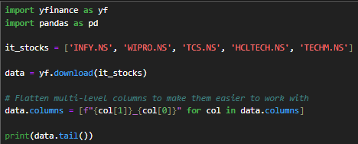
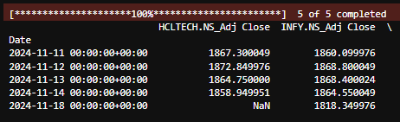
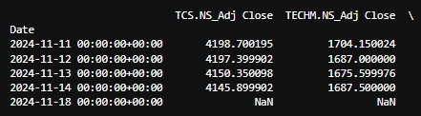
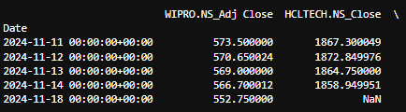
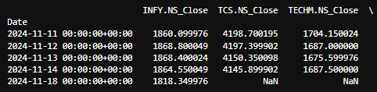
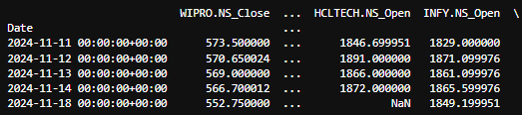
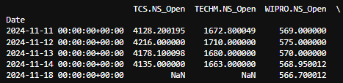
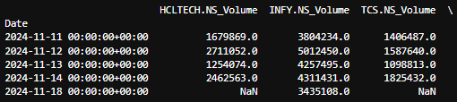
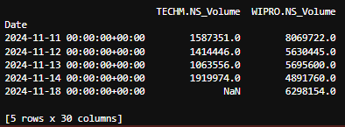
Exploratory Data Analysis
Screenshot of code:
Output:

Slide 10
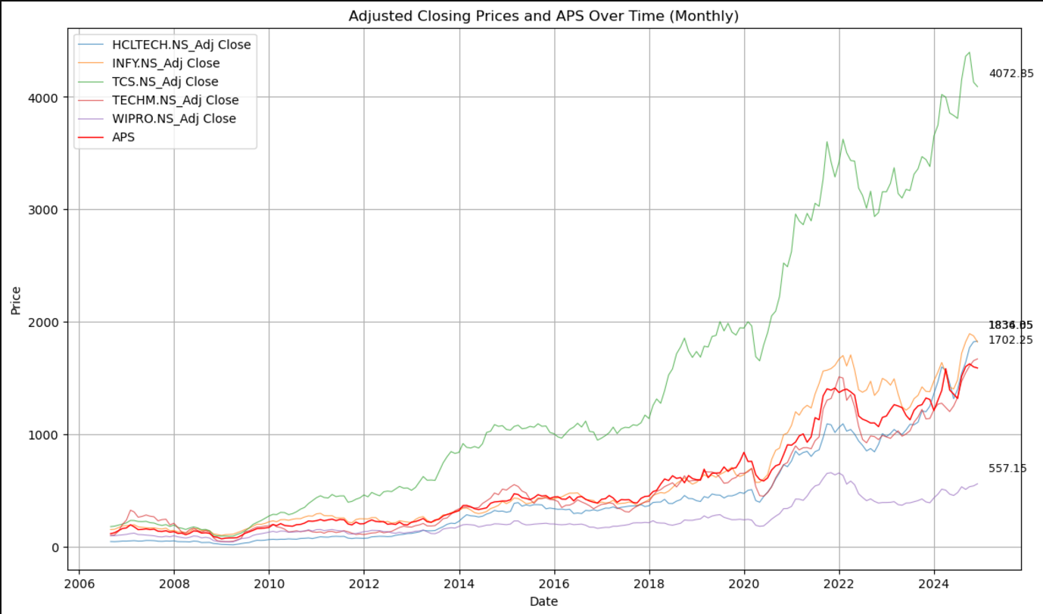
Exploratory Data Analysis (cont.)
The time series plot shows an overall upward trend in the adjusted closing prices of major Indian IT companies, with significant growth after 2020 and notable divergence between companies. Key events include a dip during the 2008 financial crisis and a sharp drop and recovery during the COVID-19 pandemic.

Slide 11
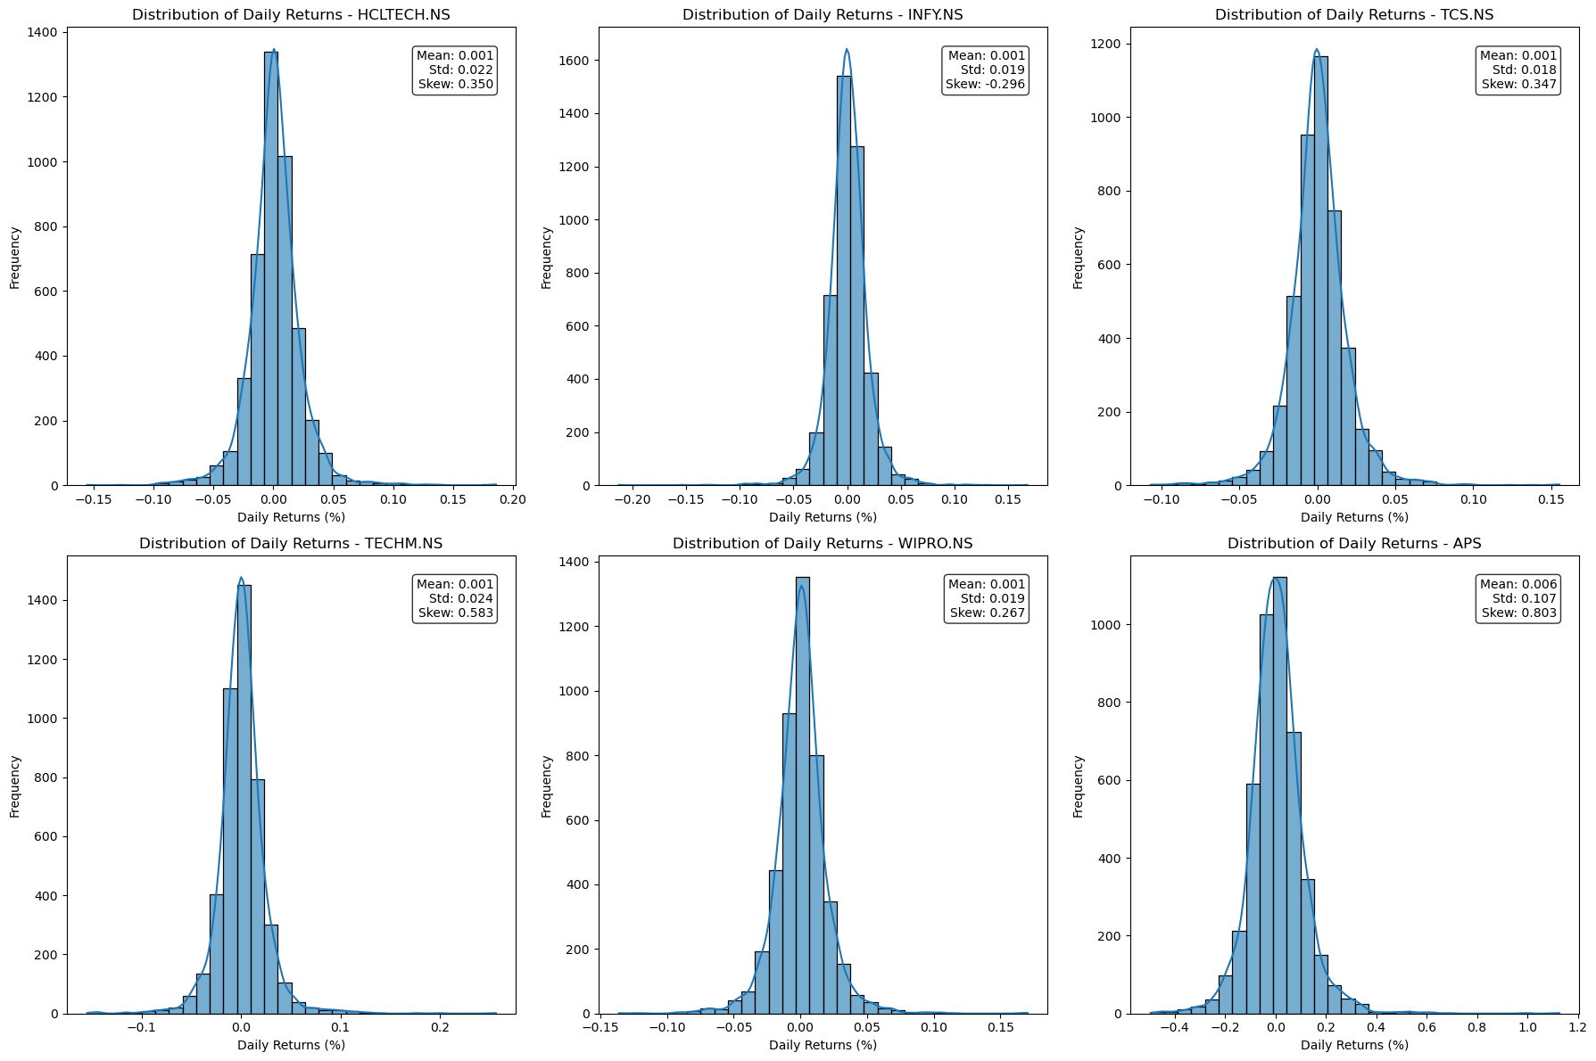
Exploratory Data Analysis (cont.)
The histograms of daily returns for all stocks show a bell-shaped distribution centered near zero, indicating that small daily price changes are most common, with rare extreme movements.

Slide 12
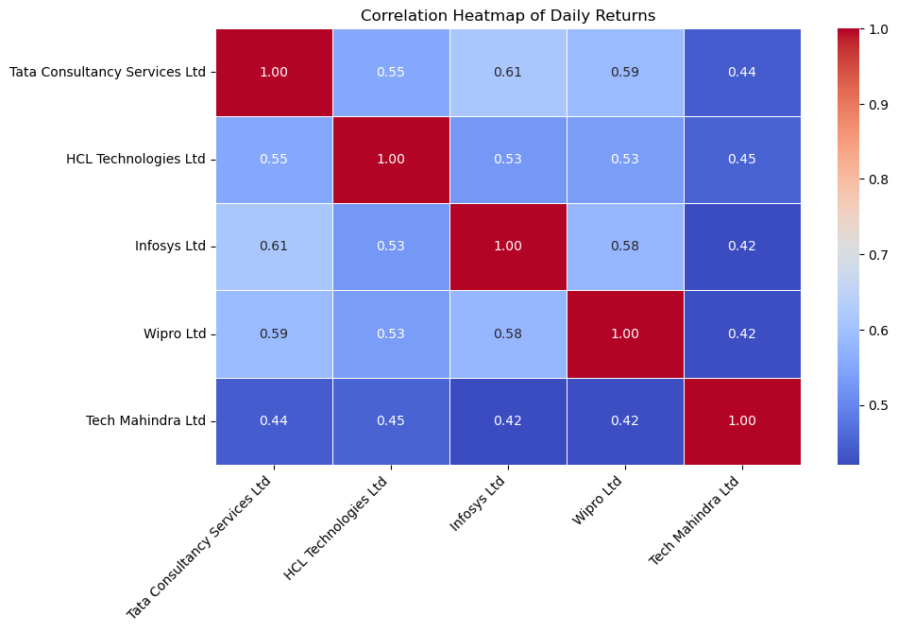
Exploratory Data Analysis (cont.)
The correlation matrix shows moderate to strong positive relationships between the stocks of major Indian IT companies, with Infosys and Tata Consultancy Services exhibiting the highest correlation at 0.61.

Slide 13
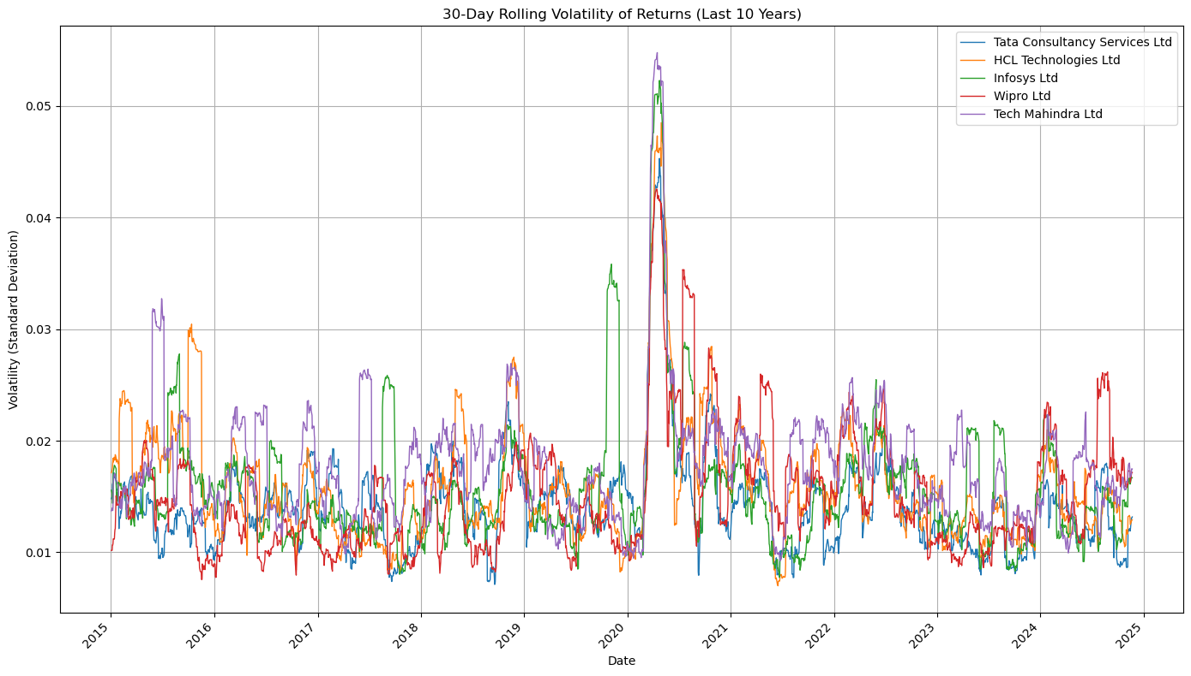
Exploratory Data Analysis (cont.)
This 30-day rolling volatility plot highlights the uncertainty in the stock market around the time of the COVID-19 pandemic lockdowns.

Slide 14
Next Step of Research Focus
The next phase involves setting up various machine learning models, performing feature selection to identify the most relevant predictors. Following model training and evaluation, event data will be integrated to further refine predictions and capture potential patterns influenced by external factors.

Slide 15
Conclusion
This study aims to enhance stock price prediction for Nifty 50 IT sector companies by leveraging machine learning models and event-driven data. Through exploratory data analysis, we have identified key trends, correlations, and periods of market volatility, providing valuable insights into the dataset. The next steps involve model development, feature selection, and the integration of external event data to refine predictions and improve accuracy. Ultimately, this research will contribute to more informed investment decisions and a deeper understanding of market dynamics in the Indian IT sector.

Slide 16
References : APA format
Base Paper:
Mohan, B., Yadav, A., Toleti, J., Reddy, D. S. S., Ahmed, R. K., & Koushitha, G. (2024). Sentiment-driven predictive models for Nifty 50 stock market fluctuations: A time series analysis perspective. IEEE International Conference on Information Technology, Electronics and Intelligent Communication Systems (ICITEICS), 70, 1–8. https://doi.org/10.1109/iciteics61368.2024.10625537
Link to Paper
Paper I:
Panchal, S. A., Ferdouse, L., & Sultana, A. (2024). Comparative analysis of ARIMA and LSTM models for stock price prediction. 2024 IEEE/ACIS 27th International Conference on Software Engineering, Artificial Intelligence, Networking and Parallel/Distributed Computing (SNPD), 240–244. https://doi.org/10.1109/snpd61259.2024.10673919
Link to Paper
Paper II:
Rajhans, A., Das, T., Kumar, A., & Sinha, B. B. (2024). Exploring the impact of financial news sentiment on stock price forecasting: A comparative deep learning approach. 2024 1st International Conference on Communications and Computer Science (InCCCS). https://doi.org/10.1109/incccs60947.2024.10593315
Link to Paper
Paper III:
Taslim, D. G., Tjahyadi, H., & Murwantara, I. M. (2024). A study of LSTM optimisation for forecasting volatile time series data. 2024 4th International Conference on Computer Communication and Artificial Intelligence (CCAI). https://doi.org/10.1109/ccai61966.2024.10603183
Link to Paper
Paper IV:
Amruth, S. J., Nigelesh, T., Shruthik, V. S., Reddy, V. S., & Venugopalan, M. (2024). Time-series-based stock market analysis using machine learning. 2024 15th International Conference on Computing Communication and Networking Technologies (ICCCNT), 1–7. https://doi.org/10.1109/icccnt61001.2024.10725232
Link to Paper

